Slide 1
Linked List
Mr. Yogesh Sharma
Assistant professor
CSE, MAIT

Slide 2
Introduction to linked list
Info Data | PTN
A linked list is a linear data structure.
the elements are not stored at contiguous memory locations.
The elements in a linked list are linked using pointers.
These elements are called as nodes.
Insertion/Deletion of nodes at any point is allowed(Beginning, Middle , End).
Random access of any element is not allowed.
Info Data | PTN
Info Data | PTN
Info Data | PTN

Slide 3
What Happens when a new nodes comes up?
Start
10
10 | X
P
20
P-> Next = Temp
10 | .
20 | X
P

Slide 4
Advantages and Disadvantages
Advantages
Dynamic Data Structure
Efficient Memory Utilization
Easy Insertion and Deletion
Disadvantages
More Memory
Random Access is time consuming

Slide 5
Array Vs Linked List
An array is the data structure that contains a collection of similar type data elements whereas the Linked list is considered as non-primitive data structure contains a collection of unordered linked elements known as nodes.
In the array the elements belong to indexes, i.e., if you want to get into the fourth element you have to write the variable name with its index or location within the square bracket.
In a linked list though, you have to start from the head and work your way through until you get to the fourth element.
Accessing an element in an array is fast, while Linked list takes linear time, so it is quite a bit slower.
Operations like insertion and deletion in arrays consume a lot of time. On the other hand, the performance of these operations in Linked lists is fast.

Slide 6
6. Arrays are of fixed size. In contrast, Linked lists are dynamic and flexible and can expand and contract its size.
7. In an array, memory is assigned during compile time while in a Linked list it is allocated during execution or runtime.
8.Elements are stored consecutively in arrays whereas it is stored randomly in Linked lists.
9.The requirement of memory is less due to actual data being stored within the index in the array. As against, there is a need for more memory in Linked Lists due to storage of additional next and previous referencing elements.
10. In addition memory utilization is inefficient in the array. Conversely, memory utilization is efficient in the linked list.

Slide 7
Operations in the Linked List
Insertion Operation (Singly Linked List)
Beginning
Middle
End

Slide 8
Insertion Operation (Singly Linked List) Beginning
Head
X
D | 0
D1 | 0
P
If P=NULL--→ Overflow
P→ info=D2
P-> next= Head
Head =P
D2 | 0
https://maitadmin-my.sharepoint.com/:v:/g/personal/yogeshs_cse_mait_ac_in/EZI_-O_47NROg6zj2hriZG4BcdwrsTKNP7AVjscbhVG0PQ?e=wcJeao

Slide 9
Insertion at Middle
Middle
Previous
New
Head
D | 0
D1 | 0
P
Prev-> next= temp
Temp->= new
D2 | 0

Slide 10
Inserting a node at the end of a linked list
Example
Input
Linked List : 10 20 30 40 NULL.
50
Output
Linked List : 10 20 30 40 50 NULL.
Input
Linked List : NULL
10
Output
Linked List : 10 NULL

Slide 11
Algorithm
1. Declare head pointer and make it as NULL.
2. Create a new node with the given data. And make the new node => next as NULL. (Because the new node is going to be the last node.)
3. If the head node is NULL (Empty Linked List), make the new node as the head.
4. If the head node is not null, (Linked list already has some elements),
find the last node.
make the last node => next as the new node.

Slide 12
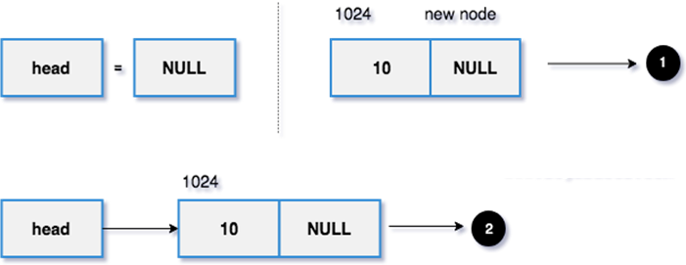
The head is NULL initially.
1. The new node with data as 10 and reference is NULL (address 1024).
2. Since it is the first node, make the head node points to the newly allocated node.

Slide 13
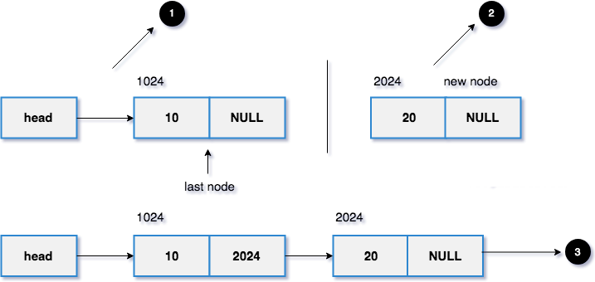
1. The head points to the memory address 1024 and it is the last node.
2. The new node with data as 20 and reference is NULL (address 2024).
set last node =>next = new node. The new node added at the end of the linked list.
3. Finally, the new linked list.

Slide 14
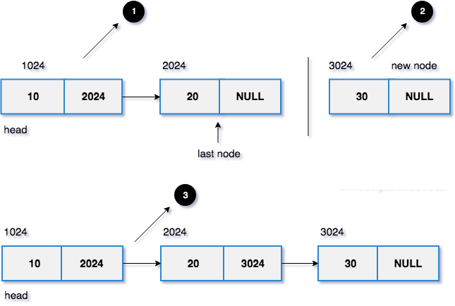
1. The head points to the memory address 1024 and it has two nodes.
2. The new node with data as 30 and reference is NULL (address 3024).
Find the last node using the loop and make the last node points to the newly allocated node.
In our case, the last node is 20 (address 2024). So, last->next = 30 (address 3024).
3. Finally, the new linked list.

Slide 15
Deletion of a Node in a Linked list
https://maitadmin-my.sharepoint.com/:v:/g/personal/yogeshs_cse_mait_ac_in/EWz447Gq3QdIlQy3b_bGbT4BJa34Ysza80y_7Io5hf47iw?e=FLsq9z

